Slide 1
ILAH - Basic Quranic Term
Edited version from the booklet
Four Basic Quranic Terms by
Abul Ala Maududi
ishaqzahid@yahoo.com
http://sabr.com

Slide 2
ILAH
Dictionary Meanings of all words derived from the root word
Became confused or perplexed.
Achieved peace and mental calm by seeking refuge with someone or establishing relations with him.
Became frightened of some impending mishap or disaster, and someone gave him the necessary shelter.
Turned to another eagerly, due to the intensity of his feelings for him.
The lost offspring of the she-camel rushed to snuggle up to its mother on finding it. Became hidden, or concealed. Also, got elevated.
Adored, offered worship to.

Slide 3
Take Four
How the verb came to mean the act of worship and the noun to denote the object of worship
Four Things to Consider

Slide 4
Four Considerations
State of being in distress, danger or need triggers adoration and submission
Belief that someone is in a position to remove his distress, to fulfill his needs, to give him shelter and protect him in time of danger, and soothe his troubled heart.

Slide 5
Four Considerations
2) Belief that He is superior in status, power, and strength

Slide 6
Four Considerations
3) Ordinary solutions do not trigger adoration
e.g. I am thirsty, and some one gives me water
I need money, and ACC hands me a check (after I fill out a form☺, I work and employer pays me
----
*** Object of worship includes in its meanings the senses of mystery, perplexity, and superiority in status, etc.

Slide 7
Four Considerations
4) Lastly, it is only natural that if one believes another to be in a position to fulfill one's needs, to provide shelter and protection, to soothe a disturbed heart and fill it with peace and calm, one turns eagerly to that person as a matter of course.

Slide 8
Four Considerations
We may therefore safely conclude from the above that the connotation of the word ilah includes the capacities to fulfill the needs of others, to give them shelter and protection, to relieve their minds of distress and agitation, superiority, and the requisite authority and power to do all these, to be mysterious in some way or hidden from men's eyes, and the turning of men eagerly to him.

Slide 9


Pre-Islamic Concepts of ILAH
And they have taken for their ilahs others than Allah, that they may according to their reckoning be a source of strength to them (or that coming under their protection may confer security). (19:81)
And they have taken others than Allah as their ilahs hoping that they might be helped when needed.
(36:74)

Slide 10
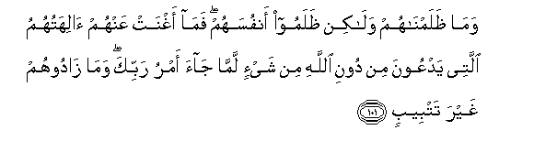
All-time Helper
11:101 It was not We that wronged them: They wronged their own souls: the deities, other than Allah, whom they invoked, profited them no whit when there issued the decree of thy Lord: Nor did they add aught (to their lot) but perdition!

Slide 11


Al-Khaliq, Al-Hayy
16:20 Those whom they invoke besides Allah create nothing and are themselves created.
16:21 (They are things) dead, lifeless: nor do they know when they will be raised up.

Slide 12
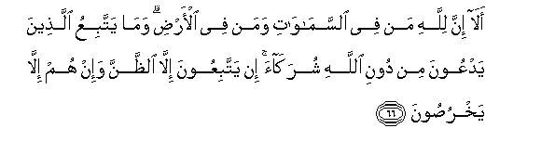
Suppositions and Idle guesses
10:66 Behold! verily to Allah belong all creatures, in the heavens and on earth. What do they follow who worship as His "partners" other than Allah. They follow nothing but fancy, and they do nothing but lie.

Slide 13
Three Aspects
These verses point to three aspects.
The first is that the Arabs used to address their prayers to those whom they regarded as their ilahs and invoke them in times of distress or for fulfilment of any of their needs.
The second is that these ilahs included not only Jinns, angels, and gods, but dead humans too, as one can see from the second of the above verses.
The third is that they believed that these ilahs could hear their prayers and could come to their rescue.

Slide 14
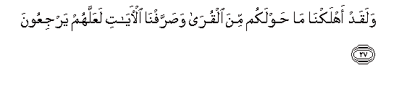
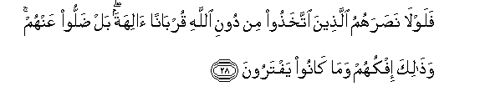
Human ILAHS Exposed
46:27 We destroyed aforetime populations round about you; and We have shown the Signs in various ways, that they may turn (to Us). 46:28 Why then was no help forthcoming to them from those whom they worshipped as gods, besides Allah, as a means of access (to Allah.) Nay, they left them in the lurch: but that was their falsehood and their invention.

Slide 15

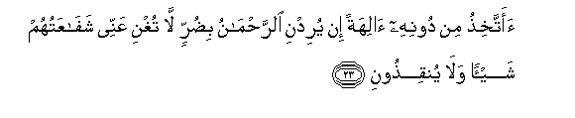
Creator; None can save or intercede
36:22 "It would not be reasonable in me if I did not serve Him Who created me, and to Whom ye shall (all) be brought back.
36:23 "Shall I take (other) Ilahs besides Him? If ((Allah)) Most Gracious should intend some adversity for me, of no use whatever will be their intercession for me, nor can they deliver me.

Slide 16
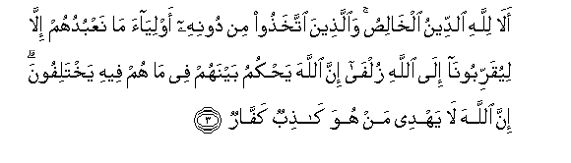
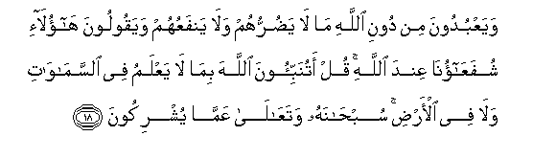
39:3 Is it not to Allah alone that sincere devotion is due? But those who take for protectors other than Allah (say): "We only serve them in order that they may bring us nearer to Allah." Truly Allah will judge between them in that wherein they differ. But Allah guides not such as are false and ungrateful.
10:18 They serve, besides Allah, things that hurt them not nor profit them, and they say: "These are our intercessors with Allah." Say: "Do ye indeed inform Allah of something He knows not, in the heavens or on earth?- Glory to Him! and far is He above the partners they ascribe (to Him)!“

Slide 17
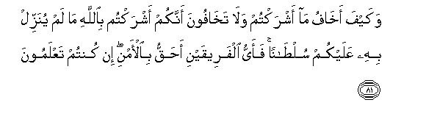
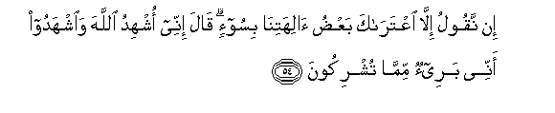
6:81 "How should I [Ibrahim] fear (the beings) you associate with Allah, when you fear not to give partners to Allah without any warrant having been given to you? Which of (us) two parties has more right to security? (tell me) if you know.
11:54 "We [Hud people] say nothing but that (perhaps) some of our gods may have seized you with imbecility." He said: "I call Allah to witness, and do you bear witness, that I am free from the sin of ascribing, to Him.
According to these verses, the Arab belief about their ilahs was that if they should give them any cause for offence or should otherwise be deprived of their favors and attentions, they would suffer epidemics, famine, lose of life and property, or other calamities.

Slide 18
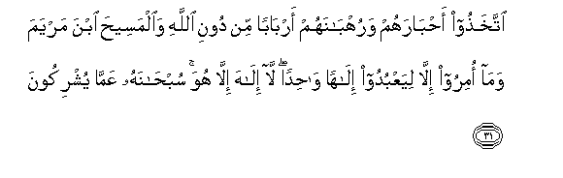
People as Rabb
They take their priests and their anchorites to be their lords in derogation of God, and (they take as their Lord) Christ the son of Mary; yet they were commanded to worship but One God: there is no ILAH but He. Praise and glory to Him: (Far is He) from having the partners they associate (with Him).(Quran 9:31)

Slide 19

Obedience to Nafs
Have you noticed the man who has made his selfish desires his ilah? Can you assume any responsibility about such a one? (Quran 25:43)
Shows Ibadah’s broad meaning that it is not just worship. It includes total obedience

Slide 20
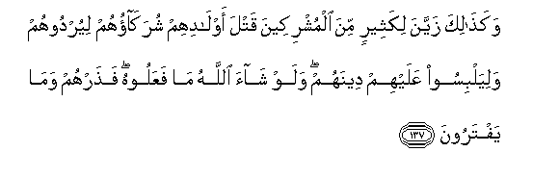
True ILAH does not command Evil
6:137 Even so, in the eyes of most of the pagans, their "partners" made alluring the slaughter of their children, in order to lead them to their own destruction, and cause confusion in their religion. If Allah had willed, they would not have done so: But leave alone them and their inventions.

Slide 21
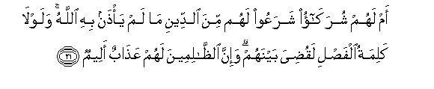
Sharia of Falsehood
42:21 What! have they partners (in godhead), who have established for them some religion without the permission of Allah. Had it not been for the Decree of Judgment, the matter would have been decided between them (at once). But verily the Wrong- doers will have a grievous Penalty.
Those who regard any custom or rule or practice with respect to Deen as permissible although it has no divine sanction, are guilty of treating the originators of the custom, etc., as having a share in divinity, i. e., of treating them as ilahs.

Slide 22
Essence of Godhead
Supreme, Supernatural Authority

Slide 23

The Quranic Approach
And He alone is the Ilah in the heavens and the Ilah in the earth; and He alone is the all-Wise, the all-Knowing (that is, He alone possesses the wisdom and the knowledge required for governing such a Domain). (Quran 43:84)

Slide 24

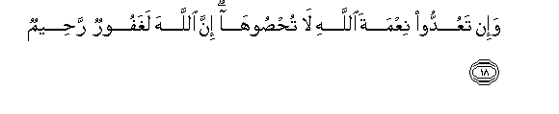

16:17 Is then He Who creates like one that creates not? Will ye not receive admonition?
16:18 If ye would count up the favors of Allah, never would ye be able to number them: for Allah is Oft-Forgiving, Most Merciful.
16:19 And Allah does know what you conceal, and what you reveal.
16:20 Those whom they invoke besides Allah create nothing and are themselves created.

Slide 25
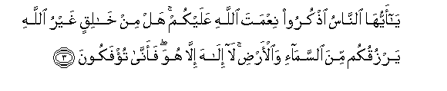
O mankind: Call unto mind the grace of Allah upon you; is there any Creator besides Allah, to give you sustenance from heaven or earth; there is no ilah but He; how, then, are you deluded from Truth? (Quran 35:3)

Slide 26
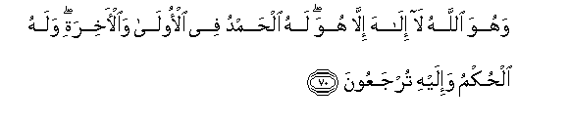
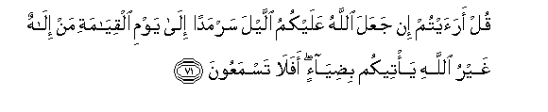
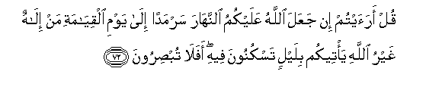
28:70 And He is Allah. There is no ILAH but He. To Him be praise and gratitude, at the first and at the last: for Him is the Command, and to Him shall ye (all) be brought back. 28:71 Say: See you? If Allah were to make the night perpetual over you to the Day of Judgment, what ILAH is there other than Allah, who can give you enlightenment? Will ye not then hearken? 28:72 Say: See ye? If Allah were to make the day perpetual over you to the Day of Judgment, what ILAH is there other than Allah, who can give you a night in which ye can rest? Will ye not then see?

Slide 27
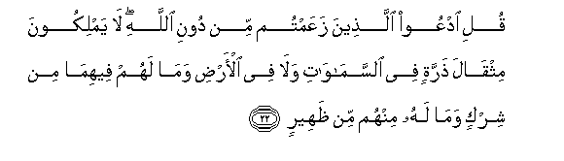
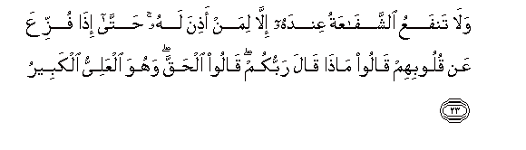
34:22 Say: "Call upon other (gods) whom ye fancy, besides Allah. They have no power,- not the weight of an atom,- in the heavens or on earth: No (sort of) share have they therein, nor is any of them a helper to Allah. 34:23 "No intercession can avail in His Presence, except for those for whom He has granted permission. So far (is this the case) that, when terror is removed from their hearts (at the Day of Judgment, then) will they say, 'what is it that your Lord commanded?' they will say, 'That which is true and just; and He is the Most High Most Great'."

Slide 28
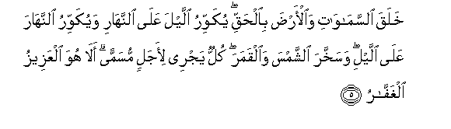
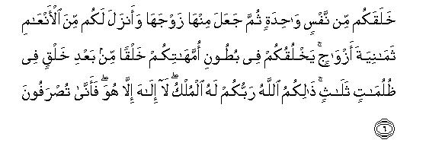
39:5 He created the heavens and the earth in true (proportions): He makes the Night overlap the Day, and the Day overlap the Night: He has subjected the sun and the moon (to His law): Each one follows a course for a time appointed. Is not He the Exalted in Power - He Who forgives again and again?
39:6 He created you (all) from a single person: then created, of like nature, his mate; and he sent down for you eight head of cattle in pairs: He makes you, in the wombs of your mothers, in stages, one after another, in three veils of darkness. such is Allah, your Lord and Cherisher: to Him belongs (all) dominion. There is no god but He: then how are ye turned away (from your true Centre)?

Slide 29
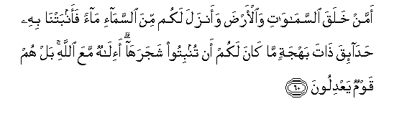
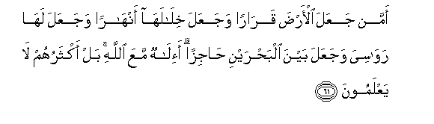
27:60 Or, Who has created the heavens and the earth, and Who sends you down rain from the sky? Yea, with it We cause to grow well-planted orchards full of beauty of delight: it is not in your power to cause the growth of the trees in them. (Can there be another) ILAH besides Allah. Nay, they are a people who swerve from justice.
27:61 Or, Who has made the earth firm to live in; made rivers in its midst; set thereon mountains immovable; and made a separating bar between the two bodies of flowing water? (can there be another) god besides Allah. Nay, most of them know not.

Slide 30
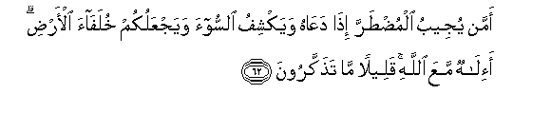
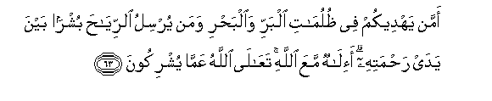
27:62 Or, Who listens to the (soul) distressed when it calls on Him, and Who relieves its suffering, and makes you (mankind) inheritors of the earth? (Can there be another) ILAH besides Allah. Little it is that ye heed!
27:63 Or, Who guides you through the depths of darkness on land and sea, and Who sends the winds as heralds of glad tidings, going before His Mercy? (Can there be another) ILAH besides Allah.- High is Allah above what they associate with Him!

Slide 31
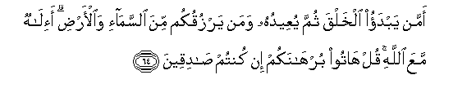
27:64 Or, Who originates creation, then repeats it, and who gives you sustenance from heaven and earth? (Can there be another) ILAH besides Allah. Say, "Bring forth your argument, if ye are telling the truth!"

Slide 32
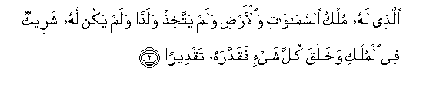
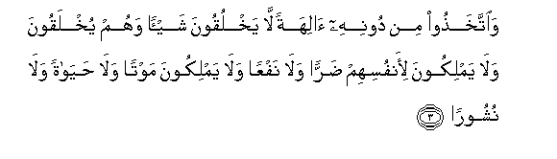
25:2 He to whom belongs the dominion of the heavens and the earth: no son has He begotten, nor has He a partner in His dominion: it is He who created all things, and ordered them in due proportions.
25:3 Yet have they taken, besides him, ILAHs that can create nothing but are themselves created; that have no control of hurt or good to themselves; nor can they control death nor life nor resurrection.

Slide 33
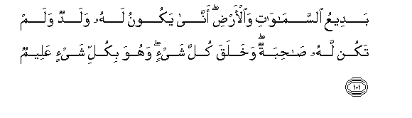
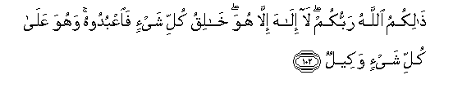
006.101 To Him is due the primal origin of the heavens and the earth: How can He have a son when He hath no consort? He created all things, and He hath full knowledge of all things.
6:102 That is Allah, your Lord! there is no god but He, the Creator of all things: then worship ye Him: and He hath power to dispose of all affairs.

Slide 34
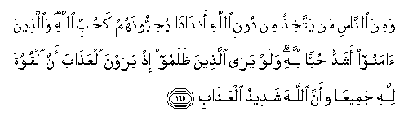
2:165 Yet there are men who take (for worship) others besides Allah, as equal (with Allah.: They love them as they should love Allah. But those of Faith are overflowing in their love for Allah. If only the unrighteous could see, behold, they would see the penalty: that to Allah belongs all power, and Allah will strongly enforce the penalty.

Slide 35
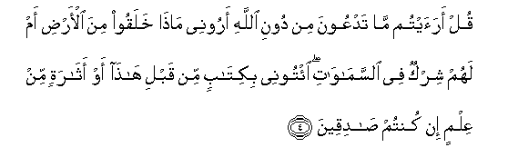
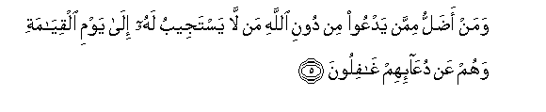
46:4 Say: "Do ye see what it is ye invoke besides Allah. Show me what it is they have created on earth, or have they a share in the heavens bring me a book (revealed) before this, or any remnant of knowledge (ye may have), if ye are telling the truth!
46:5 And who is more astray than one who invokes besides Allah, such as will not answer him to the Day of Judgment, and who (in fact) are unconscious of their call (to them)?

Slide 36
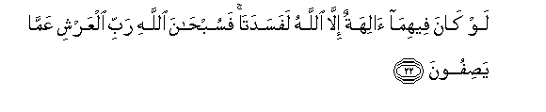

21:22 If there were, in the heavens and the earth, other gods besides Allah, there would have been confusion in both! but glory to Allah, the Lord of the Throne: (High is He) above what they attribute to Him!
21:23 He cannot be questioned for His acts, but they will be questioned (for theirs).

Slide 37
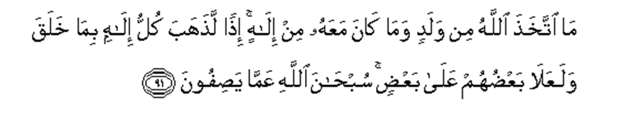
23:91 No son did Allah beget, nor is there any god along with Him: (if there were many gods), behold, each god would have taken away what he had created, and some would have lorded it over others! Glory to Allah. (He is free) from the (sort of) things they attribute to Him!

Slide 38
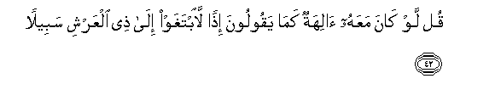

17:42 Say: If there had been (other) gods with Him, as they say,- behold, they would certainly have sought out a way to the Lord of the Throne!
17:43 Glory to Him! He is high above all that they say!- Exalted and Great (beyond measure)!

Slide 39
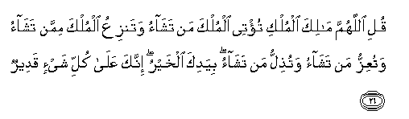
Say (O Prophet): O God! You are the Lord of all the Domains; It is You who grant kingdom to whom you please; and take it away from whomsoever You will; It is You who confer honor on whomsoever You please, and take it away from whomsoever You will. (Quran 3:26)

Slide 40

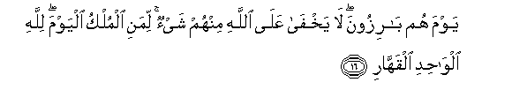
23:116 Therefore exalted be Allah, the King, the Reality: there is no god but He, the Lord of the Throne of Honor!
114:1-3 Say : I seek refuge with Him who is Rabb of all mankind, the Sovereign of all mankind, and the Ilah of all mankind.
40:16 The Day when the secrets of everyone of them will be laid bare; when it will become manifest to men that none of their actions is
hidden from God, the call will go out: To whom belongs the Dominion this Day? And the answer will invariably be: To none but Allah alone, Allah Whose power and authority transcend that of all others.
(Quran 40:16)

Slide 41
Hadith by Imam Ahmed
This verse is excellently explained in a Hadith narrated by Imam Ahmed (R) on the authority of Hazrat 'Abdullah ibn 'Umar (may Allah be pleased with both) that, on one occasion the Holy Prophet (on whom be peace) stated, in the course of a sermon, that: God will take both the heavens and the earth in His hand, and will proclaim to all before Him: I am the King; I am the Mighty one: I am the Self-exalted one; Where are the people who used to style themselves kings upon the earth, those who called themselves mighty, and who were 'their Majesties'?
Hazrat Abdullah (with whom Allah be pleased) narrates that while the Holy Prophet (peace be upon him) was repeating these words, his body trembled so much in awe of Allah Almighty that we were really afraid that he might fall from the pulpit.

