Slide 1
Section 3
The Colonial Era
Ishaq Zahid
June 2017
ishaqzahid@yahoo.com

Slide 2
The Colonial Era
Colonial Claims 1900
European Powers before WW1 – 1914
WW1: 1914 – 1918, Four MAIN Causes
Middle East after WW1
How Britain Carved Up the Middle East and Helped Create Saudi Arabia
Middle East Before and After WW2

Slide 3
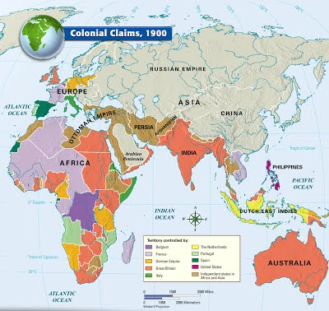

Slide 4
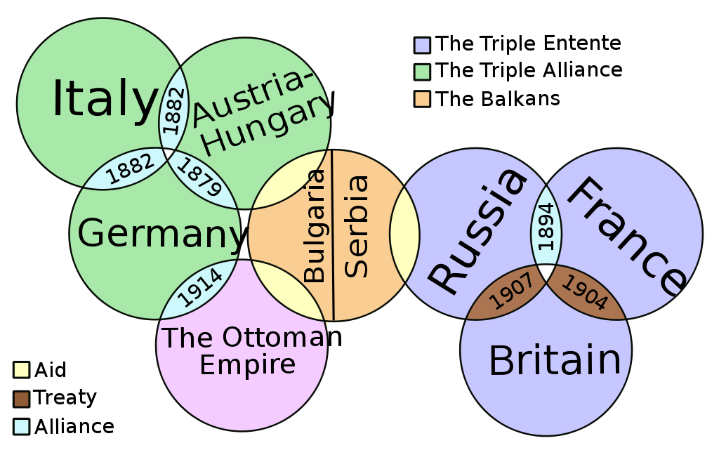
WW1: 1914 – 1918
The war began in the Balkans in late July 1914 and ended in November 1918, leaving 17 million dead and 20 million wounded.

Slide 5
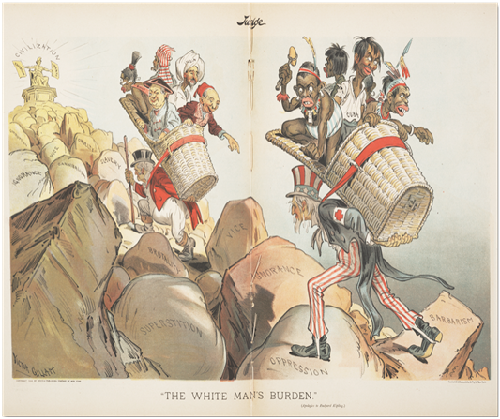
Main Causes of WW1
Polarization of Europe, 1887–1914
Imperialism
Social Darwinism
Web of alliances
Arms race
The 'Short war illusion'

Slide 6
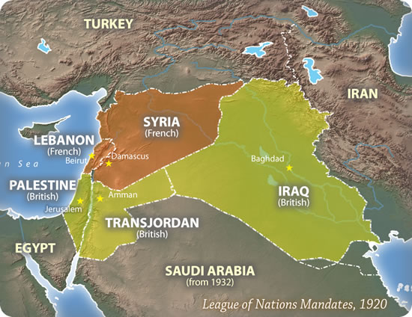
Middle East after WW1
WW1 ended The Ottoman Empire. Many new countries came into life all over the world. Below is The Middle East after WW1.

Slide 7
How Britain Carved Up the Middle East
The British strategy: Reliance on Muslim forces to promote imperial interests
Founding of the Anglo–Iranian Oil Corporation in Persia in 1908, the discovery of oil in Iraq soon after
During the First World War, Britain appealed to the Arabs in the Middle East to join it in overthrowing Ottoman rule of their territories, in exchange for British guarantees of postwar independence.

Slide 8
British government to Arabs
The British government stated to Arabs that (1914):
  ‘One of [the government’s] fundamental traditions is to be a friend of Islam and Muslums [sic] and to defend the Islamic Khalifate even if it was a Khalifate of conquest and necessity as the Turkish Khalifate which England had defended with money and men and influence several times … There is no nation amongst Muslums who is now capable of upholding the Islamic Khalifate except the Arab nation and no country is more fitted for its seat than the Arab countries’.

Slide 9
Sherif, of the holy city of Mecca, Hussein bin Ali
The British government wrote to Hussein in November 1914, stating that:
‘If the Amir [ie, Hussein] … and Arabs in general assist Great Britain in this conflict that has been forced upon us by Turkey, Great Britain will promise not to intervene in any manner whatsoever whether in things religious or otherwise … Till now we have defended and befriended Islam in the person of the Turks: henceforward it shall be in that of the noble Arab. It may be that an Arab of true race will assume the Khalifate at Mecca or Medina, and so good may come by the help of God out of all the evil that is now occurring’.

Slide 10
Lord Kitchener, the Secretary of State for war, noted in March 1915 that ‘if the Khalifate were transferred to Arabia, it would remain to a great extent under our influence.’
In his analysis of the Middle East during and after the First World War, David Fromkin notes that British leaders believed that Islam could be manipulated by buying or capturing its religious leadership. They believed, in short, that whoever controlled the person of the caliph controlled Sunni Islam.

Slide 11
Sykes-Picot Agreement
One month before the Arab revolt broke out, Britain and France secretly agreed to divide the Middle East between their zones of influence, in the Sykes-Picot Agreement, named after their respective foreign ministers.
Lawrence, in January 1916:
‘…the states [Sherif Hussein] would set up to succeed the Turks would be … harmless to ourselves … The Arabs are even less stable than the Turks. If properly handled they would remain in a state of political mosaic, a tissue of small jealous principalities incapable of cohesion’.

Slide 12
Three lessons from the Pequot War
(A side note from Americas)
The terror was very real among the Indians, but in time they came to meditate upon its foundations. They drew three lessons from the Pequot War:
that the Englishmen's most solemn pledge would be broken whenever obligation conflicted with advantage;
that the English way of war had no limit of scruple or mercy; and
that weapons of Indian making were almost useless against weapons of European manufacture.

Slide 13
Sherrif Hussein and Ibn Saud
By the end of the WW1, Ibn Saud was receiving a British subsidy of £5,000 a month – considerably less than the £12,000 a month doled out to Hussein.
Hussein was initially given £11M (around $400 million in today’s money)

Slide 14
Ibn Saud established ‘Saudi’ Arabia in an orgy of murder
Said Aburish describes Ibn Saud as ‘a lecher and a bloodthirsty autocrat … whose savagery wreaked havoc across Arabia’, terrorising and mercilessly slaughtering his enemies. The conquest of Arabia cost the lives of around 400,000 people, since Saud’s forces did not take prisoners; over a million people fled to neighbouring countries. Numerous rebellions against the House of Saud subsequently took place, each put down in ‘mass killings of mostly innocent victims, including women and children’. By the mid-1920s most of Arabia had been subdued, 40,000 people had been publicly executed and some 350,000 had had limbs amputated; the territory was divided into districts under the control of Saud’s relatives, a situation which largely prevails today.

Slide 15
Britain’s Other Clients
The British recognised Ibn Saud’s control of Arabia, and by 1922 his subsidy was raised to £100,000 a year by Colonial Secretary Winston Churchill.
Britain continued to exploit its other potential clients: Faisal, who, with the Allies had captured Damascus in 1918, was made King of Iraq in 1921, and Abdullah, Sherif Hussein’s other son, was dubbed King of Transjordan, which became ‘independent’ under British ‘protection’ in 1923.

Slide 16
Puppet Regimes
The regimes that Britain had created were puppets, essentially law-and-order governments allied mainly with the traditional ruling classes of Islam. In turn, these favoured sultans, emirs or monarchs saw British rule as providing protection against the dangers of instability or emancipatory nationalist movements that had begun to stir, notably in Iraq.

Slide 17
World War II: 1939-1945
World War II began 21 years after the end of World War I, but many historians believe that the two wars were part of one vast global conflict.

Slide 18
World War II Casualties
World War II was the deadliest military conflict in history in absolute terms of total casualties. Over 60 million people were killed, which was about 3% of the 1940 world population (est. 2.3 billion). World War II fatality statistics vary, with estimates of total deaths ranging from 50 million to more than 80 million. The higher figure of over 80 million includes deaths from war-related disease and famine. Civilians killed totaled 50 to 55 million, including 19 to 28 million from war-related disease and famine. Military deaths from all causes totaled 21 to 25 million, including deaths in captivity of about 5 million prisoners of war.

Slide 19
The Deadliest Century
The 20th century was the most murderous in recorded history.
The aftermath of World War II was the beginning of an era defined by the decline of the old great powers and the rise of two superpowers: the Soviet Union (USSR) and the United States of America (USA), creating a bipolar world. ... Europe was divided into a US-led Western Bloc and a Soviet-led Eastern Bloc.

Slide 20

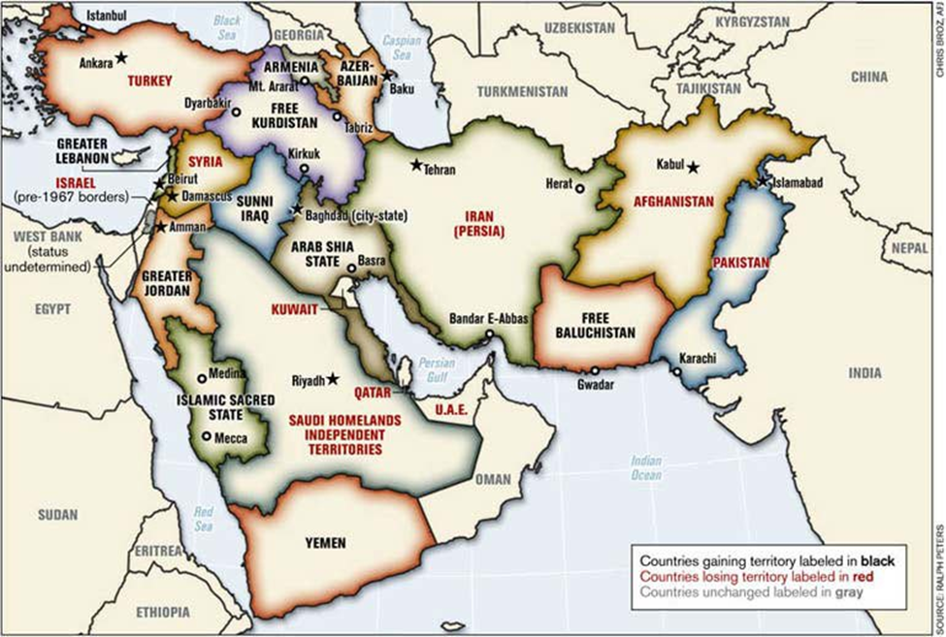
Middle East Before & After WW2

Slide 21
World After WW2
Colonialism ended. Countries were given freedom. Colonialists left the land but put puppet regimes behind.
The world thus turned to Neo-Imperialism – The Current State.
See the next Section 4

Slide 22
Note of References
The British government quoted texts source is http://markcurtis.info/
Mark Curtis, a British historian and journalists compiled these in his books and articles from the unclassified files of the British.

