Slide 1
State of the World
Recent Past and Present
Lecture Series
Section 1: The Christian Era
Dr. Ishaq Zahid
June 2017
IshaqZahid@yahoo.com

Slide 2
The Christian Era
1. The Roman Empire at the time of Jesus (a.s.)
2. A Study of Mithraism by Martin Luther King Jr.
3. The Bible by Newsweek, Double Issue, January 2015
    a. The good book is so misquoted it's a sin by Newsweek
    b. Playing Telephone with the Word of God by The Newsweek
    c. Translation Transubstantiation by The Newsweek
    d. The Sociopath Emperor by The Newsweek
4. The Bloody History of Papal Rome—A Timeline
5. Medieval Torture Devices
6. Worst Torture in Medieval Times
7. Behind the Vault – Hidden Lessons from the Rise and Fall of Muslim Spain by Dr. Abdullah Hakim Quick

Slide 3
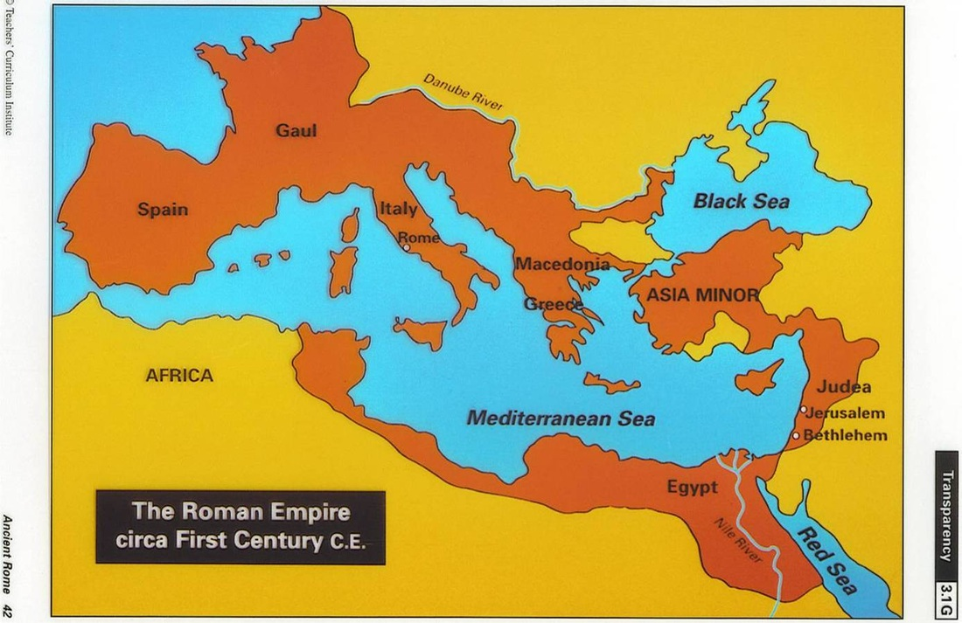
The Roman Empire
The Roman Empire at the time of Jesus (a.s.)
State of Jewish Religious Leadership and their cause and effects for the Centuries that followed
Notes:
Latin as first official language, then Greek imposed by Alexander the Great. Latin remained dominant in the West, while Greek in Easter side. In 5th century, only east side remained as “Byzantine Empire”

Slide 4
Religions at the Time of Jesus
Plurality of gods existed in Greek, Asian and Ancient Egyptian& other mythologies.
Threesomes of male deities, of female deities, of Father-Mother-Son groups, or of one body with three heads, or three faces on one head.
Also popular in the Roman Empire was Mithraism, a religion that believed Mithras as the son of god who came down to Earth and sacrificed himself for humanity.
Yet another popular religion within the Roman Empire was worship of the sun

Slide 5
The Influence of Mithraism on Christianity
“When Mithraism is compared with Christianity, there are surprisingly many points of similarity. Of all the mystery cults Mithraism was the greatest competitor of Christianity. The cause for struggle between these two religions was that they had so many traditions, practices and ideas that were similar and in some cases identical.”
Reference: Author: King, Martin Luther, Jr. (Crozer Theological Seminary)

Slide 6
A Study of Mithraism
“The belief in immortality, a mediator between god and man, the observance of certain sacramental rites, the rebirth of converts, and (in most cases) the support of high ethical ideas were common to Mithraism as well as to Christianity. In fact, the comparison became so evident that many believed the Christian movement itself became a mystery cult.”
(King, Martin Luther, Jr.)

Slide 7
Mithraism to Christianity
“The greatest influence of Mithraism on Christianity lies in a different direction from that of doctrine and ritual. It lies in the fact that Mithraism paved the way for the presentation of Christianity to the world of that time.”
(King, Martin Luther, Jr.)

Slide 8
Mithraism ⬄ Christianity
“(1) Both regarded Sunday as a holy day.
(2) December 25 came to be considered as the anniversary of the birth of Mithra and Christ also.
(3) Baptism and a communion meal were important parts of the ritual of both groups.
(4) The rebirth of converts was a fundamental idea in the two cults.”
(King, Martin Luther, Jr.)

Slide 9
Mithraism ⬄ Christianity
“(5) The struggle with evil and the eventual triumph of good were essential ideas in both religions.
(6) In both religions only initiates who passed through certain preliminary phases of introduction were admitted to the mysteries which brought salvation to converts.
There were many more similarities between Christianity and Mithraism.”
Read full article at https://kinginstitute.stanford.edu/king-papers/documents/study-mithraism

Slide 10
The Quran on Christianity
. قُلْ يَا أَهْلَ الْكِتَابِ لَا تَغْلُوا فِي دِينِكُمْ غَيْرَ الْحَقِّ وَلَا تَتَّبِعُوا أَهْوَاءَ قَوْمٍ قَدْ ضَلُّوا مِن قَبْلُ وَأَضَلُّوا كَثِيرًا وَضَلُّوا عَن سَوَاءِ السَّبِيلِ ﴿٧٧﴾
Say, "O People of the Scripture, do not exceed limits in your religion beyond the truth and do not follow the inclinations of a people who had gone astray before and misled many and have strayed from the soundness of the way." (5:77)

Slide 11
Dr. Jerald Dirks
https://youtu.be/k94n1GfBbcw?t=1456

Slide 12
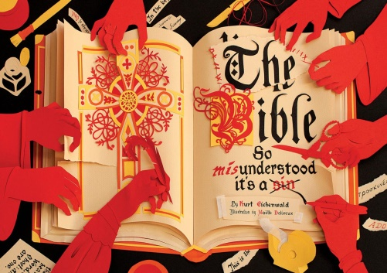
The Bible (Newsweek Issue – 1/2015)
The Articles are based in large part on the works of scores of theologians and scholars, some of which dates back centuries.
No one has read the Bible, not even the Pope! We’ve all read a bad translation—a translation of translations of ….
John 5:7 (“For there are three that bear record in heaven, the Father, the Word, and the Holy Ghost: and these three are one”) first appeared in KJB and is not in Greek copies.
With a little translational trickery, a fundamental tenet of Christianity—that Jesus is God—was reinforced in the Bible

Slide 13
weshouldgoeatmom
Manuscripts were originally written in Koiné, or “common” Greek, and not all of the amateur copyists spoke the language or were even fully literate. Some copied the script without understanding the words.
Koiné was written in what is known as scriptio continua—meaning no spaces between words and no punctuation.
Example: weshouldgoeatmom
Sentences can have different meaning depending on where the spaces are placed: For example, godisnowhere
(Newsweek)

Slide 14
“He that is without sin among you, let him first cast a stone.’’
A group of Pharisees and others bring a woman caught committing adultery to Jesus. Under Mosaic Law—the laws of Moses handed down in the Old Testament—she must be stoned to death. The Pharisees ask Jesus whether the woman should be released or killed, hoping to force him to choose between honoring Mosaic Law and his teachings of forgiveness. Jesus replies, “He that is without sin among you, let him first cast a stone.’’ The group leaves, and Jesus tells the woman to sin no more.
Unfortunately, John didn’t write it. Scribes made it up sometime in the Middle Ages. It does not appear in any of the three other Gospels or in any of the early Greek versions of John. Even if the Gospel of John is an infallible telling of the history of Jesus’s ministry, the event simply never happened. Moreover, according to Ehrman, the writing style for that story is different from the rest of John, and the section includes phrases that do not appear anywhere else in the Bible. Scholars say they are words more commonly used long after that Gospel was written. (Newsweek)
Notes:
A woman caught committing adultery (John 7:53 …)
It’s a powerful story, known even by those with just a passing knowledge of the Bible. It was depicted in Mel Gibson’s movie The Passion of the Christ

Slide 15
The Pentecostal snake-handlers
Gospel of Mark, 16:17-18.
Those who believe in Jesus will speak in tongues and have extraordinary powers, such as the ability to cast out demons, heal the sick and handle snakes.
Pentecostal ministers often babble incomprehensible sounds, proclaiming—based in part on these verses in Mark—that the noises they are making show that the Holy Spirit is in them.
A primary justification for the emergence of the Pentecostal snake-handlers.
(Newsweek)

Slide 16
The earliest versions of Mark stop at 16:8
The 12 verses that follow in modern Bibles—Jesus appearing to Mary Magdalene and the Disciples and then ascending to Heaven—are not there.
A significant moment that would be hard to forget, one would think.
(Newsweek)

Slide 17
Some Critical Portions of the Bible
John 5:7 (“For there are three that bear record in heaven, the Father, the Word, and the Holy Ghost: and these three are one”);
Luke 22:20 (“Likewise also the cup after supper, saying, This cup is the new testament in my blood, which is shed for you”); and
Luke 24:51 (“And it came to pass, while he blessed them, he was parted from them, and carried up into heaven”).
These first appeared in manuscripts used by the translators who created the King James Bible, but are not in the Greek copies from hundreds of years earlier.
(Newsweek)

Slide 18
The Bible:
So Misunderstood It's a Sin
These are not the only parts of the Bible that appear to have been added much later. There are many, many more—in fact, far more than can be explored without filling up the next several issues of Newsweek.
Taken from:
The Bible: So Misunderstood It's a Sin By Kurt Eichenwald / December 23, 2014
Newsweek Magazine
http://www.newsweek.com/2015/01/02/thats-not-what-bible-says-294018.html

Slide 19
A Summary
For centuries, Christians were certain God had guided the hand not only of the original writers but also of all those copyists.
But in the past 100 years or so, tens of thousands of manuscripts of the New Testament have been discovered, dating back centuries.
What biblical scholars now know is that later versions of the books differ significantly from earlier ones.
In fact, even copies from the same time periods differ from each other. “There are more variations among our manuscripts than there are words in the New Testament,” says Dr. Bart D. Ehrman
(Newsweek)

Slide 20
The Trinity
The Trinity—the belief that Jesus and God are the same and, with the Holy Spirit, are a single entity—is a fundamental, yet deeply confusing, tenet.
So where does the clear declaration of God and Jesus as part of a triumvirate appear in the Greek manuscripts?
Nowhere. And in that deception lies a story of mass killings.
(Newsweek)

Slide 21
Early Christianity
Why would God, in conveying his message to the world, speak in whispers and riddles?
It seems nonsensical, but the belief that he refused to convey a clear message has led to the slaughter of many thousands of Christians by Christians.
In fact, Christians are believed to have massacred more followers of Jesus than any other group or nation.
Those who believed in the Trinity butchered Christians who didn’t.
(Newsweek)

Slide 22
3, 2, 1, Crucifixion & Slaughters
Groups who believed Jesus was two entities—God and man—killed those who thought Jesus was merely flesh and blood.
Some felt certain God inspired Old Testament Scriptures, others were convinced they were the product of a different, evil God.
Some believed the Crucifixion brought salvation to humankind, others insisted it didn’t,
And still others believed Jesus wasn’t crucified.
(Newsweek)

Slide 23
Early Gospels
For many centuries, Christianity was first a battle of books and then a battle of blood.
Most sects had their own gospels
There was the Gospel of Mary Magdalene, the Gospel of Simon Peter, the Gospel of Philip and the Gospel of Barnabas. (See http://barnabas.sabr.com )
(Newsweek)

Slide 24
Emperor Constantine
Constantine was a brutal sociopath who murdered his eldest son, decapitated his brother-in-law and killed his wife by boiling her alive, and that was after he proclaimed that he had converted from worshipping the sun god to being a Christian.
Yet he also changed the course of Christian history.
(Newsweek)

Slide 25
Primary dispute: Jesus was God
The followers of a priest named Arius said, that God created Jesus. Arianism https://www.britannica.com/topic/Arianism
But Constantine sided with those who believed Jesus was both God and man, so a statement of belief, called the Nicene Creed, was composed to proclaim that.
Those who refused to sign the statement were banished. Others were slaughtered.
(Newsweek)

Slide 26
Nicene Creed Rewritten
About 50 years later, in CE 381, the Romans held another meeting, this time in Constantinople. There, a new agreement was reached:
Jesus wasn’t two, he was now three—Father, Son and Holy Ghost.
The Nicene Creed was rewritten, and those who refused to sign the statement were banished, and another wholesale slaughter began,
This time of those who rejected the Trinity, a concept that is nowhere in the original Greek manuscripts and is often contradicted by it.
(Newsweek)

Slide 27
The Bible is a very human book
The Bible is a very human book. It was written, assembled, copied and translated by people.
That explains the flaws, the contradictions, and the theological disagreements in its pages.
Once that is understood, it is possible to find out which parts of the Bible were not in the earliest Greek manuscripts, which are the bad translations, and what one book says in comparison to another, and then try to discern the message for yourself.
(Newsweek)

Slide 28
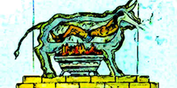
18 Medieval Torture Devices
Example:
Brazen Bull – Torture Device
The Brazen Bull torture device originated in Greece. The Brazen Bull was made of Bronze. Victims were heated alive inside the Brazen Bull.

Slide 29
Worst Torture in Medieval Times
The Middle, Dark Ages or Medieval Times, in Europe was a long period of history from 500 CE to 1500 CE. That's 1000 years! It includes the time from the fall of the Roman Empire to the rise of the Ottoman Empire.

Slide 30
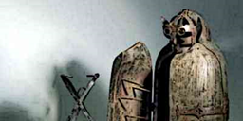
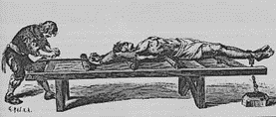
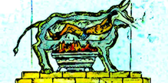
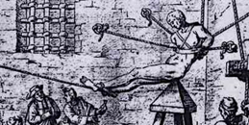
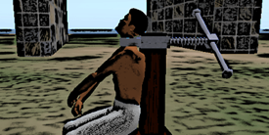
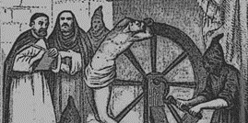

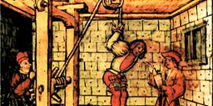
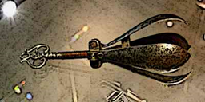
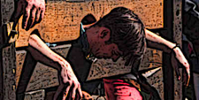
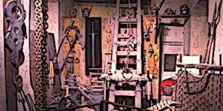
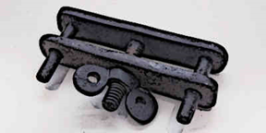
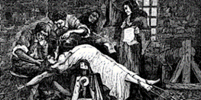
Extraordinary tools of torture
The Brazen Bull torture device
Torture with a Saw
Breaking Wheel Torture
Torture on the Iron Chair
Torture on the Rack
Using rats for torture
Wooden Horse Torture
Pear of Anguish Torture
Breast Ripper torture
Hung, Drawn and Quartered
Iron Maiden torture
Knee splitter torture, …

Slide 31
State of the World - Recent Past and Present
Lecture Series
Part of lecture series:
Section 1: The Christian Era
Section 2: The Muslim Era
Section 3: The Colonial Era
Section 4: The Neo Imperialism Era

